Slide 1
2.3:
Classes
ICS 3U/3C
David Beilby
Zeyad Nasr
Thomas Brittain

Slide 2
Classes
Pieces of code that allow you to ‘bunch’ data together.
Creates objects that can have different methods and variations as defined by the coder.
Some examples may be:

Slide 3
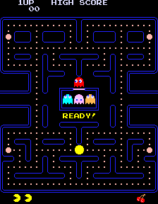
Classes
Pieces of code that allow you to ‘bunch’ data together.
Creates objects that can have different methods and variations as defined by the coder.
Some examples may be:
The different parts of PAC-MAN > Ghosts, pellets, walls etc.

Slide 4
Classes
Pieces of code that allow you to ‘bunch’ data together.
Creates objects that can have different methods and variations as defined by the coder.
Some examples may be:
The different parts of PAC-MAN > Ghosts, pellets, walls etc.
Similar to subprograms, classes allow us to reduce repetition.

Slide 5

Creating Classes
Class statements are defined with:
The class statement
An initialize function > def __init__(self,args):
Any other sub programs below.

Slide 6
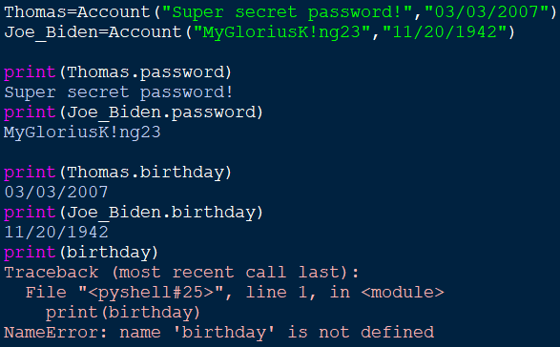
Creating Classes
The initialize function __init__() is always run when a class is defined.
Passing self ensures that variables are saved to each unique class object we create.
Here we can see that the variables are stored locally within the classes.
The variable scope of anything assigned to self is local to ONLY it’s class > It must be called using self within the class or the name of the class outside.
Global variables may be specified: global var_name

Slide 7
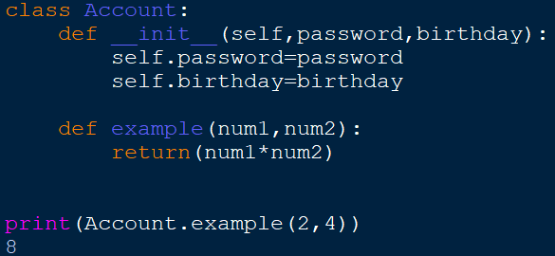
Functions in Classes
Classes may also contain subprograms that are called without class objects.
These subprograms are used the same as any other subprogram, except we have to call them with the class:
class.checkbalance()

Slide 8
Challenge!
Create a rectangle class with getArea() and getPerimeter() functions!

Slide 9
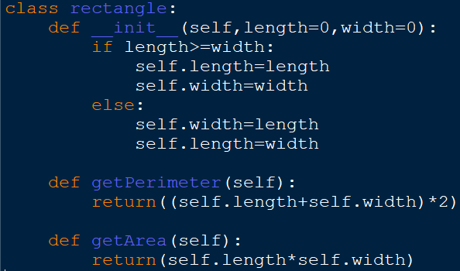
Creating a Rectangle Class

Slide 10
Inheritance
Inheritance is the money, property or title one gets as an heir at the death of the previous holder.

Slide 11
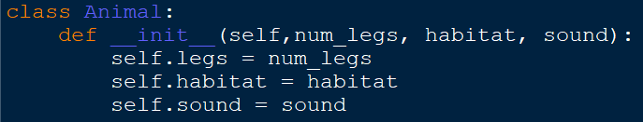
Inheritance
Inheritance allows us to extend the properties, attributes, and methods of one class to another that we define.
The initial class is referred to as the parent/super class. The new class that we define is called a child/sub classes.

Slide 12
Inheritance
Inheritance will take the closest argument for a function, the one in the ‘newest’ child class.

Slide 13
Challenge!
Create an animal superclass with different animal subclasses.

